Slide 1
Disability Related Issues A Changing Landscape
Dr. Deborah Larew
Director
Valencia College
dlarew@valenciacollege.edu
(407) 582-2236

Slide 2
Educators….

Slide 3
Today:
Why we do what we do
What is required
When are accommodations not appropriate
How do we prepare and protect ourselves, our programs, standards, and students

Slide 4
Civil Rights Legislation
1973 First legislation prohibiting discrimination on the basis of a disability
1975 IDEA (P.L. 94-142)
1990 Americans with Disabilities Act (ADA)
2008 ADA Amendment Act
Reasonable Accommodations
http://www.motherjones.com/mojo/2015/07/americans-disabilities-act-capitol-crawl-anniversary
Notes:
http://www2.ed.gov/about/offices/list/osers/idea35/history/index_pg10.html
http://www2.ed.gov/about/offices/list/ocr/docs/hq9805.html

Slide 5
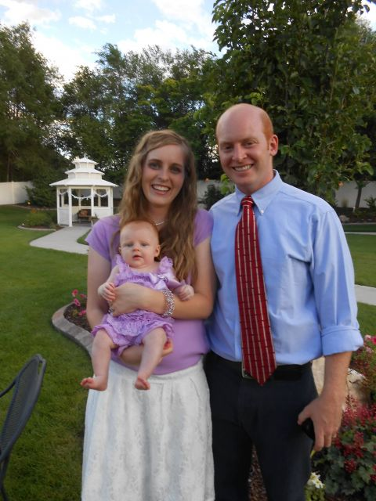
Recent Decisions and Developments
Palmer College of Chiropractic
https://www.insidehighered.com/news/2014/06/30/iowa-supreme-court-says-chiropractic-college-discriminated-against-blind-student
UC Davis School of Medicine
http://www.ucdmc.ucdavis.edu/medschool/features/2011-2012/01/20111207_som_deaf_student.html
Johns Hopkins Hospital
http://www.baltimoresun.com/health/bs-hs-deaf-nurse-20160121-story.html
Creighton Medical School
https://www.insidehighered.com/news/2013/12/23/us-judge-orders-creighton-medical-school-provide-specific-services-deaf-student
Pacific Northwest University of Health Sciences
https://www.insidehighered.com/news/2014/07/28/judge-orders-medical-college-accommodate-deaf-student
Notes:
http://www.baltimoresun.com/health/bs-hs-deaf-nurse-20160121-story.html

Slide 6
Compliance
Office of Civil Rights (U.S. Department of Education)
At the postsecondary level, the recipient (institution receiving federal aid) is required to provide students with appropriate academic adjustments and auxiliary aids and services that are necessary to afford an individual with a disability an equal opportunity to participate in a school's program.

Slide 7
NOTICE!
The laws require an EQUAL OPPORTUNITY ….Not a passing grade.
Students must still master the same learning outcomes with or without reasonable accommodations, modifications, auxiliary aids.

Slide 8
Two Exceptions to Accommodation
Office of Civil Rights (U.S. Department of Education)
Recipients are not required to make adjustments or provide aids or services that would result in a
fundamental alteration of a recipient's program or
impose an undue burden.

Slide 9
Reasonable Accommodation
Tool needed to do the “job”
Software
Specialized equipment or services
Modifications in the way work is done or modification of policies
Extended time on tests
Course substitutions
Determine who, at your institution, is responsible for determining 1) disability status, and 2) accommodations
Notes:
https://www2.ed.gov/policy/gen/leg/foia/acshbom3.pdf

Slide 10
Decisions must be made through
The interactive process looking at standards and accommodation requests
A NON- stereotypical biases
Not based on the institutional “liability”
Not based on “how we’ve always done it”

Slide 11
Decide Before the Request!
Program standards written in behavioral terms
Communicate:
Read the patient’s medical chart and/or physician’s orders
Communicate verbally in English to the patient in order to converse, instruct, relieve anxiety…
With or without reasonable accommodations
Motor Skills
Physically be able to administer emergency care including performing CPR
Be able to stand for periods as long as 2 hours wearing a lead apron and to walk a distance of 2 miles during a normal work day
With or without reasonable accommodations
Notes:
http://valenciacollege.edu/west/health/documents/RadiographyProgramGuide2016-2017.pdf

Slide 12
Clinical and Job Placements
All of the institution’s programs must be accessible.
Title IX
EEOC
ADA
We oversee whether or not the student has met all of our program standards. We do not promise that any workplace will hire our graduate.

Slide 13
Bottom line….
Learning outcomes must be mastered by all students with or without reasonable accommodations.
Make decisions about essential functions of a program before the need arises
Make decisions in partnership with your disability professionals and general counsel
Don’t assume that just because it hasn’t been done before that it can’t be done now.

Slide 14
Valenciacollege.edu

