Slide 1
Cardiac and Vascular Sonography Educators’ Luncheon
September 29, 2016

Slide 2
6th Annual Cardiovascular Educators’ Forum
April 7-8, 2016
Westin Las Vegas
Application will be available next month
on CCI website

Slide 3
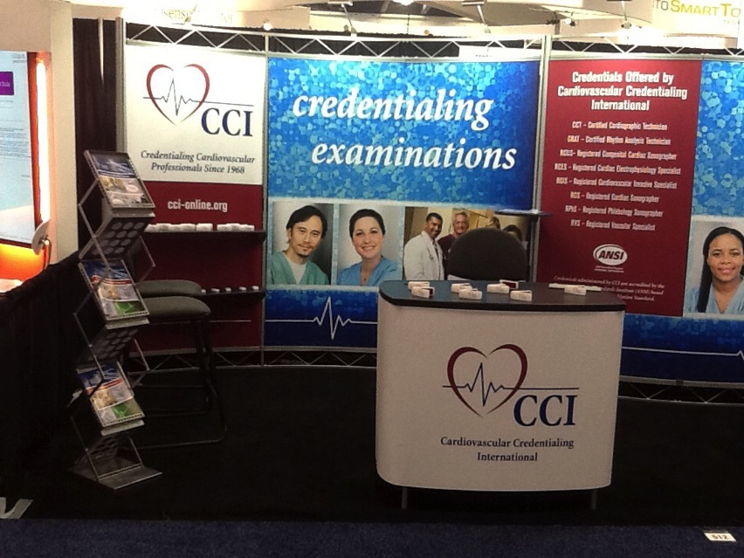
Visit us at Booth #417

Slide 4
Thank You Gift
CCI thanks you for attending today’s luncheon and please pick up one CCI tumbler on your way out.

